Slide 1

MACHINE LEARNING – COURSE PROJECT
Chest X-Ray Classification
From Classical ML to DannyNet
Reproducing & Improving CheXNet on the NIH ChestX-ray14 dataset
An iterative deep-learning research journey

Slide 2



The Problem
Why does automated chest X-ray classification matter?
2 billion+
Severe class imbalance
54% of images are 'No Finding'; rare diseases like Hernia appear in only 0.2% of cases.
chest X-rays performed worldwide every year
Multi-label complexity
A single X-ray may show several diseases at once. 836 unique label combinations exist.
Yet many regions face severe radiologist shortages - making AI-assisted diagnosis a clinically urgent need.
Subtle visual signals
Distinguishing diseases requires identifying low-contrast patterns invisible to the untrained eye.
2 / 17

Slide 3
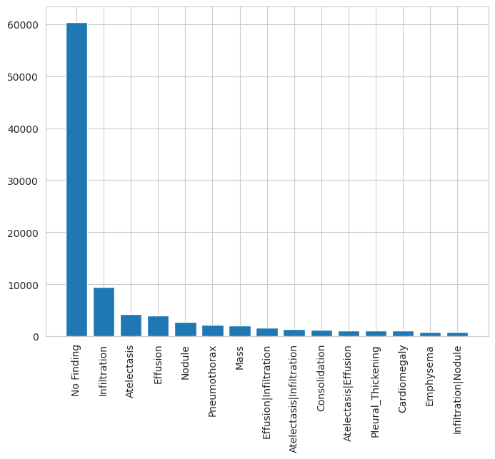
Dataset: NIH ChestX-ray14
One of the largest publicly available medical imaging datasets
112,120
30,805
14
>90%
frontal-view X-rays
unique patients
disease classes
label accuracy (NLP)
Key properties
Multi-label format - each X-ray can have 0, 1, or many disease labels
836 unique label combinations observed in the dataset
Patient-level grouping - same patient often has multiple X-rays (leakage risk)
Source: Wang et al., NIH 2017
Label distribution - heavily skewed toward 'No Finding'
3 / 17

Slide 4
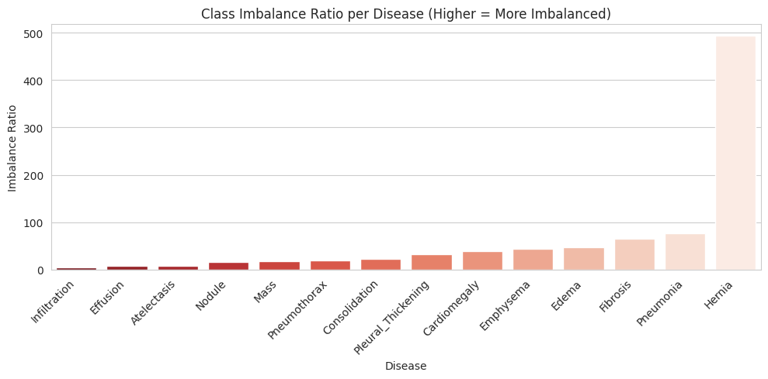


The Imbalance Problem
Why a single 'accuracy' number is misleading on this dataset
The trap
A model that always predicts 'no disease' achieves ~90% accuracy - and zero clinical value.
Our metrics
AUC-ROC - how well the model ranks positives above negatives
F1 score - harmonic mean of precision & recall after a binary decision
Imbalance ratio per disease - Hernia is ~493× rarer than its negatives
4 / 17

Slide 5
Our Research Journey
Iterative simplification, then a return to the full problem armed with insights
01
Exploratory Data Analysis
Understand label distribution, age/gender bias, disease co-occurrence patterns
02
Binary Classification (Atelectasis vs Effusion)
Classical ML - HOG features → CNN features → ResNet50+PCA → MLP. Baselines: ~70-79% AUC
03
3-Class Multi-Backbone CNN
Scale to 3 classes (Atelectasis, Effusion, No Finding) using DenseNet121 + ResNet50 ensemble. AUC ≈ 0.77
04
Full 14-Class DannyNet (paper reproduction)
DenseNet-121 + Focal Loss + AdamW + per-class threshold tuning. Mean AUC ≈ 0.83
5 / 17

Slide 6
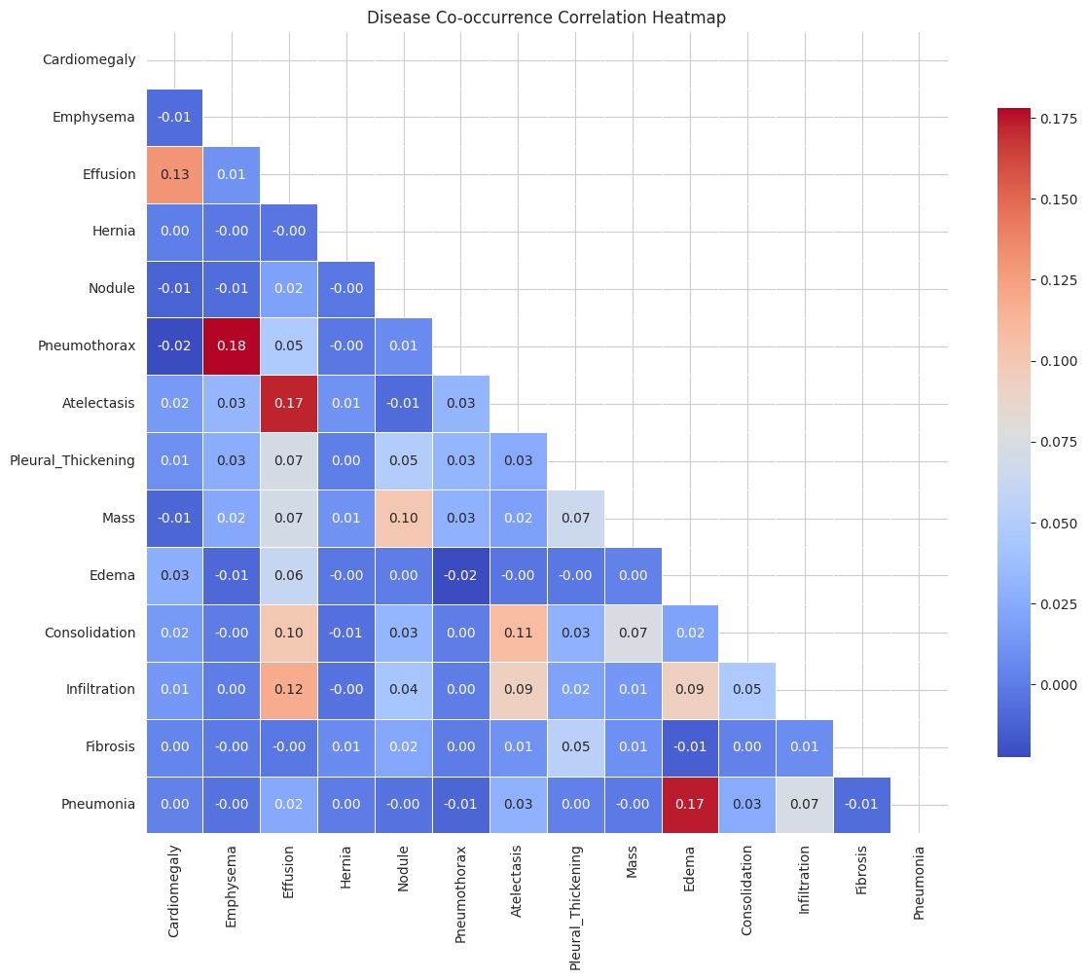

EDA Insight: Diseases Co-occur
Why a multi-label approach is essential
Strongest disease pairings
Pneumothorax ↔ Emphysema
ρ = 0.18
Edema ↔ Pneumonia
ρ = 0.17
Effusion ↔ Atelectasis
ρ = 0.17
Effusion ↔ Cardiomegaly
ρ = 0.13
Effusion ↔ Infiltration
ρ = 0.12
Implication
Single-label classification cannot capture clinical reality - the model must support multiple simultaneous diagnoses.
6 / 17

Slide 7
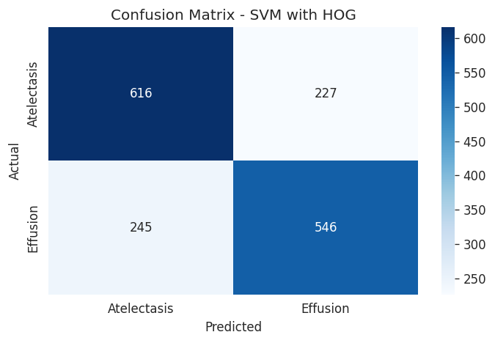
Phase 2: Binary Classical-ML Baselines
Atelectasis vs Effusion - building intuition before tackling the full problem
Feature extraction × classifier comparison
Approach | Best Model | Accuracy | AUC
HOG features | SVM (RBF) | 0.71 | 0.772
ResNet50 features | SVM (RBF) | 0.72 | 0.790
ResNet50 + PCA (974 comp) | SVM (RBF) | 0.71 | 0.788
ResNet50 + PCA | MLP | 0.70 | 0.787
EfficientNet-B4 fine-tuned | End-to-end CNN | 0.73 | 0.795
Best classical model: SVM with HOG
Takeaway
Even with the simplified 2-class setup, classical ML plateaus around 70-72% accuracy. Deep CNN features modestly outperform handcrafted HOG, but the ceiling is clear - we need end-to-end learning on more data.
7 / 17

Slide 8
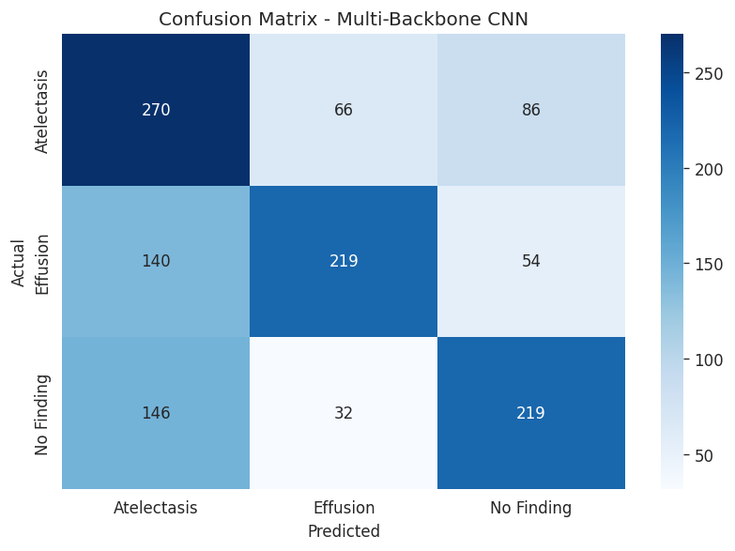
Phase 3: Multi-Backbone CNN (3 classes)
Atelectasis vs Effusion vs No Finding — DenseNet121 + ResNet50 ensemble
Architecture
Input (224×224 RGB)
↓
DenseNet-121 (frozen) + ResNet-50 (frozen)
↓ Concatenate (1024 + 2048 = 3072 dim)
↓ Dense(512) + Dropout + Softmax(3)
Two-phase training
Phase 1: Train classifier head only (backbones frozen)
Phase 2: Fine-tune last 30 layers of each backbone
Test accuracy: 57.5% Macro AUC: 0.771
Improvement over binary baseline, but the model still confuses Atelectasis with No Finding heavily.
8 / 17

Slide 9


What We Learned Before the Reproduction
Insights from 8 prior experiments shaped the final model design
Class imbalance is the dominant problem
Multi-label > single-label
Standard losses + uniform thresholds always favor the majority class. Need per-class strategies.
Diseases co-occur. Forcing one label per image throws away clinically real information.
End-to-end CNN > frozen feature extraction
Patient-level splits are non-negotiable
Pretrained features alone cap at ~72%. Full fine-tuning unlocks meaningfully higher AUC.
Same patient appears in many X-rays. Image-level splits leak data and inflate metrics.
9 / 17

Slide 10
Phase 4: DannyNet - Final Reproduction
Reproducing Strick, Garcia & Huang (2025): improvements over original CheXNet
Five key design choices
Training Setup
1
DenseNet-121 backbone
ImageNet-pretrained, fully fine-tuned
Dataset
NIH ChestX-ray14 (~112k images)
2
Focal Loss (γ=2, α=1)
Split
70 / 10 / 20 - patient-level
Down-weights easy negatives, focuses on hard rare positives
Image size
224 × 224, ImageNet normalization
3
AdamW optimizer
Batch size
32
lr = 5e-5, decoupled weight decay
Epochs
20 (best at epoch 6)
4
Color Jitter + RRC
Augmentation: RandomResizedCrop, HorizontalFlip, ColorJitter
Scheduler
ReduceLROnPlateau
Per-class F1 thresholds
Hardware
Kaggle T4 ×2
5
Sweep validation set per disease - not global 0.5
Tracking
Weights & Biases
10 / 17

Slide 11
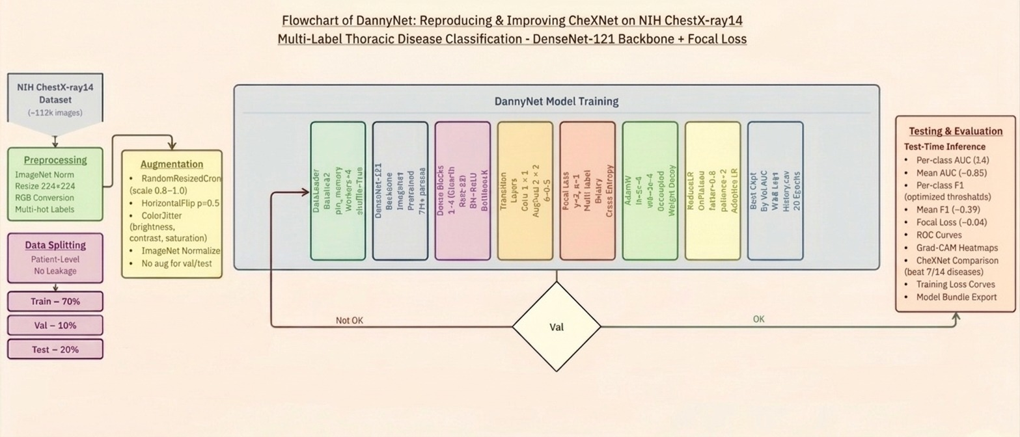
Flowchart

Slide 12
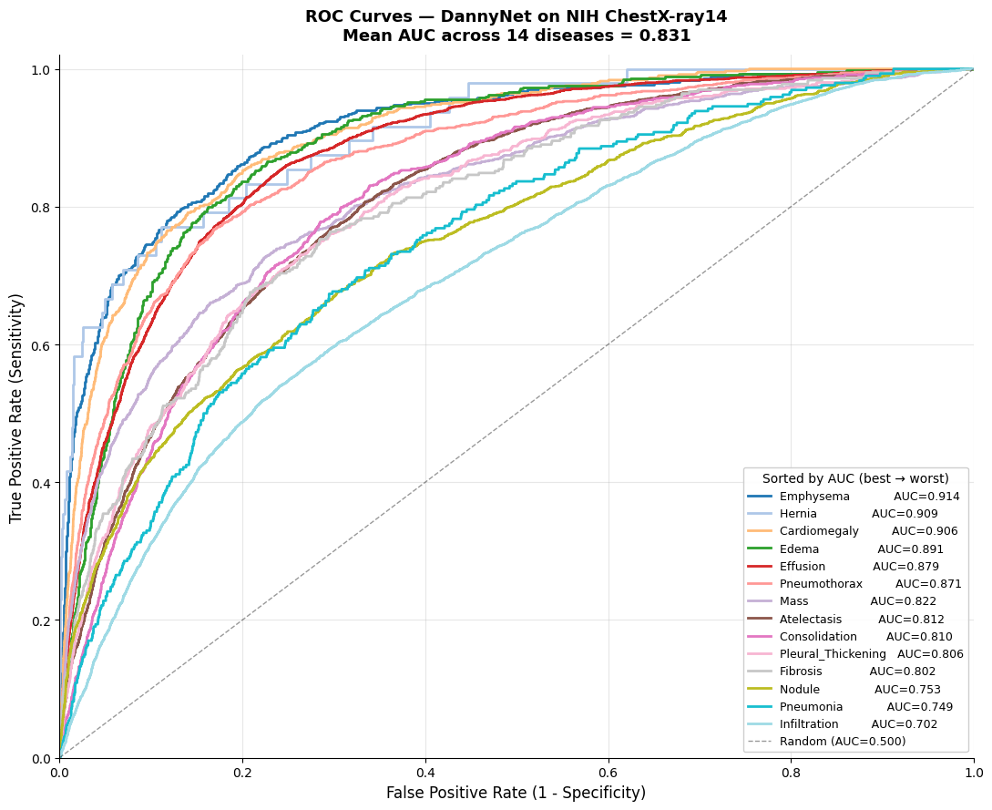
DannyNet - Test Set Results
Performance across all 14 thoracic disease classes
0.312
0.042
0.831
Mean Test AUC
Mean Test F1
Test Loss
across 14 diseases
with per-class thresholds
Focal Loss
Best & worst diseases
Emphysema
0.914
Hernia
0.909
Cardiomegaly
0.906
Nodule
0.753
Pneumonia
0.749
Infiltration
0.702
Top 3 are well-localized findings; bottom 3 share diffuse, overlapping presentations.
ROC curves - sorted by AUC
11 / 17

Slide 13
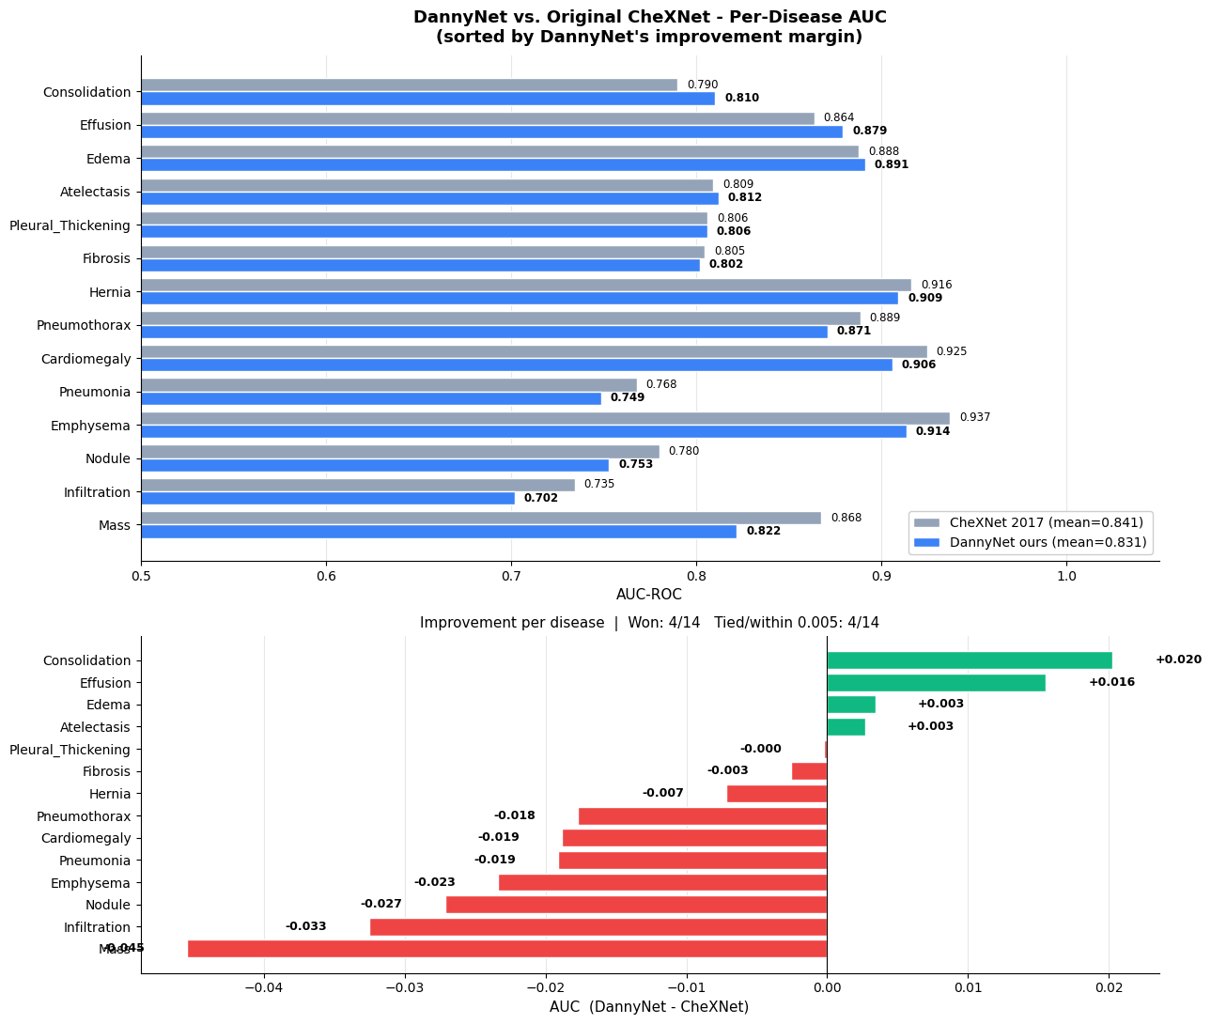
DannyNet vs. Original CheXNet
Per-disease AUC comparison - honest results from our reproduction
How we compare
4 / 14
diseases improved
10 / 14
diseases regressed
Honest note
Mean AUC fell short of paper's 0.85 (we hit 0.83) - early stopping at epoch 6 likely limited convergence.
12 / 17

Slide 14
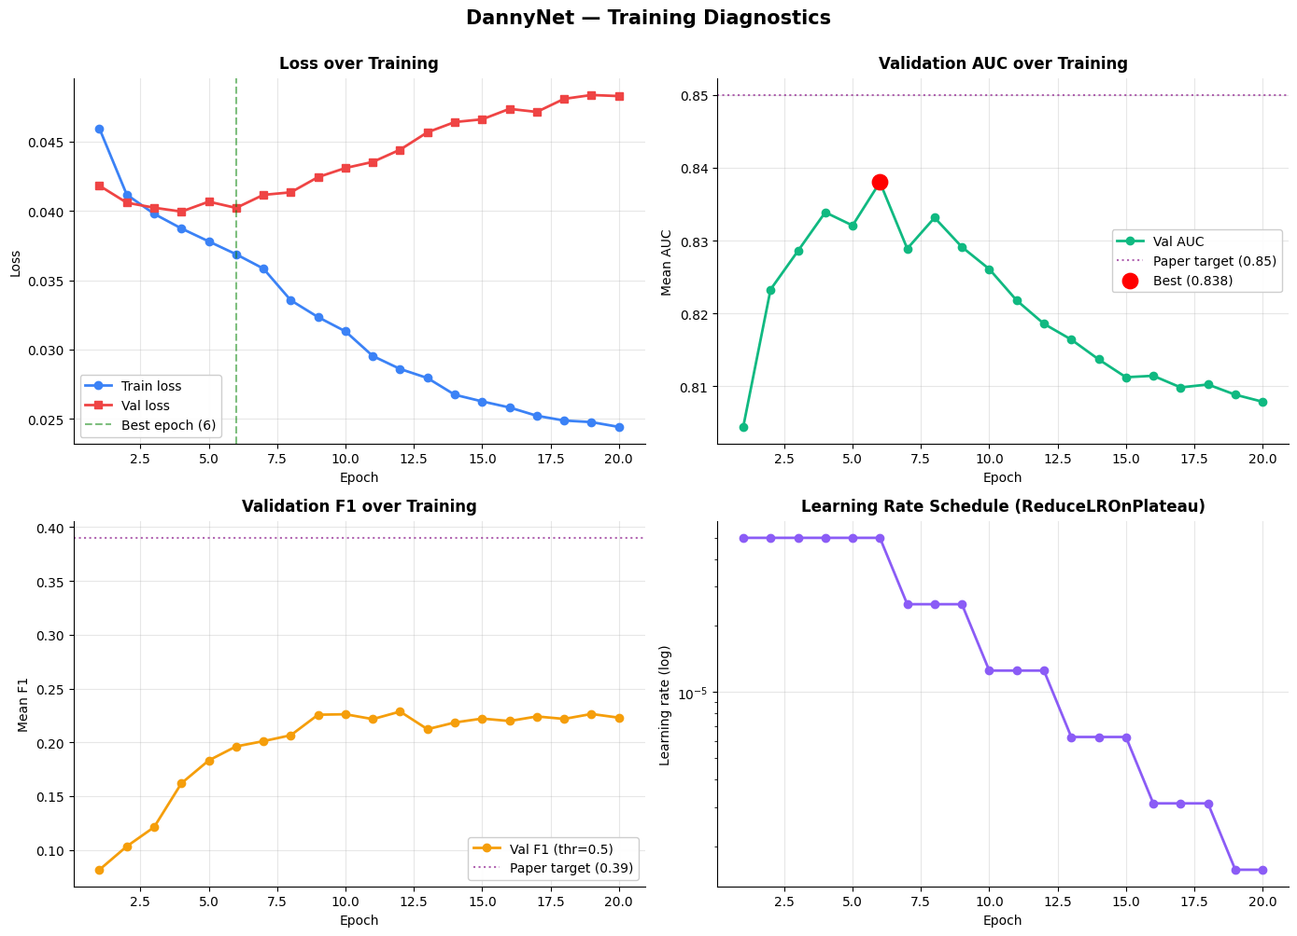
Training Diagnostics
What the loss curves tell us about what went well - and what didn't
Key observations
Best epoch: 6
Val AUC peaks at 0.838 then plateaus
Visible overfitting
Val loss rises after epoch 5 while train loss keeps falling
LR schedule worked
ReduceLROnPlateau cuts LR cleanly when val loss stalls
F1 plateaus at 0.22
Default 0.5 threshold cap - solved by per-class tuning
13 / 17

Slide 15
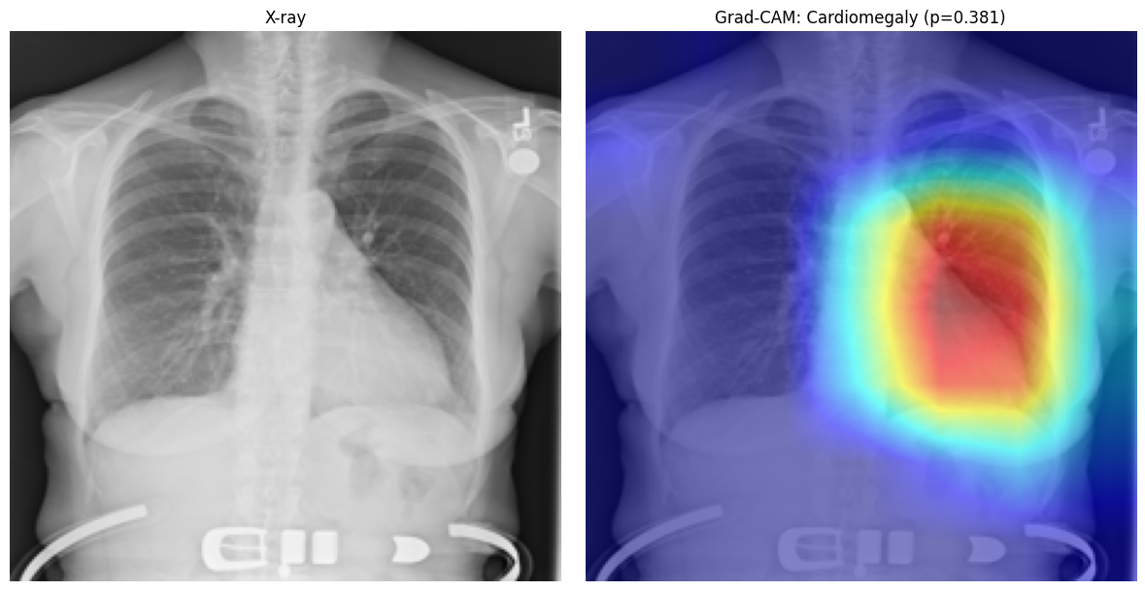
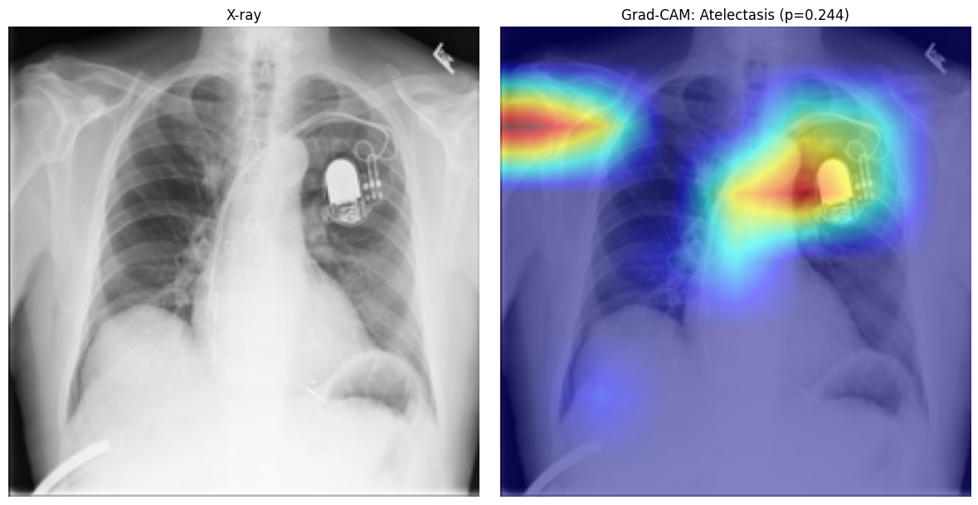
Grad-CAM: Where Is the Model Looking?
Visualizing model attention — does it focus on clinically meaningful regions?
Cardiomegaly (p = 0.381)
Atelectasis (p = 0.244)
Heatmap precisely locates the heart silhouette - clinically correct localization.
Lower confidence; attention is on a pacemaker shadow rather than lung tissue.
Interpretability builds trust - but also reveals shortcut learning from medical devices in the frame.
14 / 17

Slide 16
The Full Picture
How metrics evolved across our 4 phases
↑
Difficulty grew
From 2 → 3 → 14 classes; from binary → multi-label
↗
AUC held strong
Despite 14× more classes, mean AUC matched simpler setups
★
Real research arc
Each phase informed the next - paper reproduction was the destination, not the start
15 / 17

Slide 17

Limitations & Future Work
Honest reflection on what we'd do next
Limitations
Future directions
Did not match paper's 0.85 mean AUC (reached 0.83) - early stopping at epoch 6
Medical-pretrained weights (TorchXRayVision, RadImageNet)
F1 of 0.31 is below paper's 0.39 - threshold tuning helped but not enough
Try Vision Transformers and ConvNeXt backbones
ImageNet-pretrained weights - domain mismatch for grayscale radiographs
Loss reweighting + oversampling for ultra-rare classes (Hernia, Pneumonia)
NIH labels are NLP-derived (~90% accurate), not clinician-verified
Bounding-box supervision using NIH BBox annotations
16 / 17

Slide 18
Thank you
Questions, critiques, and discussion welcome.
EDA → DannyNet
Mean AUC 0.83
14 diseases

